Slide 1


Storage
BackUp
Sistemas de backup

Slide 2


Caracteristicas generales:
    Hot Swap Fuentes y Discos
    Doble redundancia Ventiladores y Fuentes
    Doble Controladores
    Conexión externa: Fiber Channel de 4 - 8 Gbps
    Dispone de detección automática para conectarse a 1Gb, 2Gb, 4Gb ó 8Gb
    RAID soportados: 0, 1, 3, 5, 6, 10

Slide 3

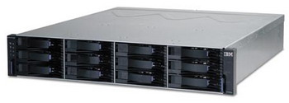
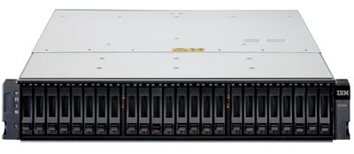
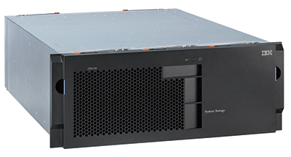
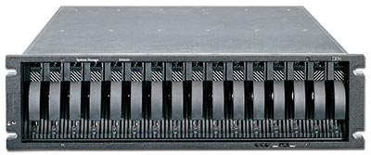
Modelo | Foto | Cantidad de discos | Cache x controladora | Capacidad fisica | Particion
DS3400 |  | 12 de 3,5’’ | 512 MB | 7.2 TB SAS 24 TB SATA | 4, 8, 16, 32
DS3500 Express |  | 12 de 3,5’’ | 1GB | 7.2 TB SAS 24 TB SATA | 8, 16, 32, 64, 128
DS4800 Series |  | 16 | 4,8 GB | 300 GB 15.000 RPM, 400, 500 y 750 GB 7200 rpm SATA | 64
DS5020 Express |  | 16 | 4,8,16,32 GB | 50.4 TB FC SAS 112 TB SATA | 128

Slide 4



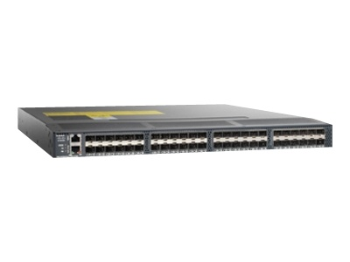
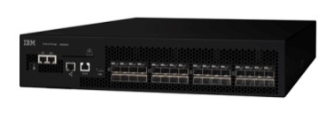
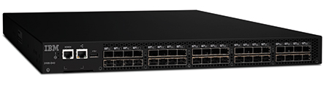
Modelo | Foto | Bocas | Velocidad (canales)
IBM SAN24B-4 Express |  | 8, 16 y 24 | 1,2,4,8 Gbps
Cisco MDS 9124 Express |  | 8, 16, 24 | 1,2,4 Gbps
Cisco MDS 9148 |  | 16, 24, 32, 40,48 | 1,2,4,8 Gbps
IBM SAN32B-E4 |  | 16, 24, 32 | 1,2,4,8 Gbps
IBM SAN40B-4 |  | 24,32,40 | 1,2,4,8 Gbps

Slide 5

Que es un Tape Drive ?
Dispositivo destinado a almacenar datos en cintas magnéticas
Los formatos de cartuchos que podemos encontrar son DAT/DDS, DLT y LTO
LTO es lineal, multi-canal, bi-direccional de formatos, corrección de errores de código para obtener la máxima capacidad y rendimiento

Slide 6
LTO-5:
Cartucho de datos de 1,5 TB (3,0 TB con compresión 2:1)
Interfaces Faber Chanel de 8 Gbps y SAS de 6 Gbps
Velocidades de transferencia de datos nativos de hasta 140 MegaBytes por segundo (MBps)

Slide 7

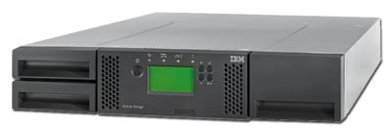
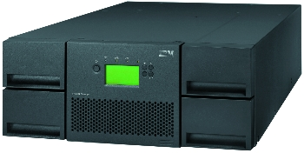
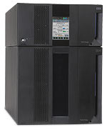
Modelo | Foto | Números de Unidades | Max. Sistema | Max. Cartucho
TS3100 Express |  | 1 LTO estándar 2 LTO media | 36 TB nativos 72 TB comp | 24
TS3200 Express |  | 2 LTO estándar 4 LTO media | 72 TB nativos 144 TB comp | 48
TS3310 (3576 Model L5B) |  | 2 LTO | 61.5 TB nativos 123 TB comp | 41
TS3310 (3576 Model L5B and four E9U models) |  | 18 LTO | 1.2 PB comp | 409

Slide 8

TS3310:
Modular, biblioteca de cintas escalable diseñado para expansión
Configuración de montaje en rack
Diseñado para una óptima eficiencia de almacenamiento
Hot-swap unidades de cinta y fuentes de alimentación
Alimentación redundante y opciones de conectividad host ruta de conmutación por error
Incluye toda la robótica e inteligencia necesarias para gestionar el sistema de biblioteca

Slide 9


Soluciones de Almacenamiento
Es un software para utilizar y gestionar copias de seguridad y recuperación de datos.
Cada servidor se une al Backup de dominio para permitir una gestión centralizada.

Slide 10

San network
Lan free backup
Server less backup
5 key tecnologies used in SAN (by ibm)

Slide 11
Soluciones de Almacenamiento
Components
Tivoli Storage Manager as a system is made up of several different components. The major components of TSM include: TSM Server, TSM Client, TSM Storage Agent, and TSM Administration Center. Each of these provides important functionality to a Tivoli Storage Manager system.
The most common data source for TSM is the TSM Backup/Archive Client, which allows backup and restore of data "selectively," and "incrementally". This is generally known as "Progressive Incremental" or "Incremental Forever" as each unique client+filespace+path+file combination is separately tracked for retention.[edit]
Notes:
IBM Tivoli Storage Manager (TSM or ITSM) is a centralized, policy-based, enterprise class, data backup and recovery package. The software enables the user to insert objects not only via backup, but also through space management and archive tools. It also allows retrieval of the same data via similar restore, recall, and retrieve methods.

Slide 12
Soluciones de Almacenamiento
Cada servidor se une al Backup de dominio para permitir una gestión centralizada.
Software de IBM que permite automatizar las funciones de copias de respaldo de datos y su recuperación.
Centraliza las operaciones de gestión de almacenamiento
Utiliza el método progresivo incremental para hacer los backups
De este modo, elimina backup redundantes al realizar solo una vez el full backup
Soporta lan free data movement:
You are able to configure the Tivoli Storage Manager client and server so that the client, through a storage agent, can move its data directly to storage on a SAN. This function, called LAN-free data movement, is provided by the Managed System for SAN feature. As part of the configuraion, a storage agent is installed on the client system. Tivoli Storage Manager supports both tape libraries and FILE libraries.

Slide 13
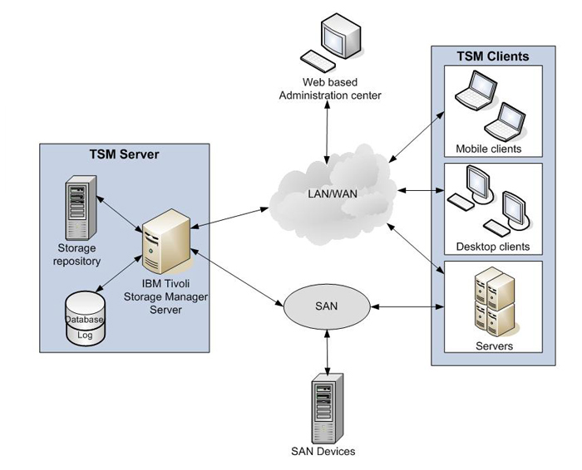

Slide 14

Tivoli Storage Manager for Storage Area Networks
Overview
IBM Tivoli® Storage Manager for Storage Area Networks works with servers and client computers to make data transfers over SAN
Allows SAN-connected Storage Manager servers and Storage Manager client computers to make maximum use of their direct network connection to storage.
Reduces the impact of data protection on the LAN while also reducing CPU utilization on both client and server
LAN-free backup/restore that removes data transfer from the LAN, providing high-performance backup/restore and minimizing network traffic, improving application performance and transaction response times on the TSM server
Supports a SAN-connected tape library, where multiple servers can share a tape library and tape drives on a Storage Area Network
Operating systems supported: AIX, HP-UX, Linux, Solaris (Sun microsystems), Windows family, z/OS

Slide 15
Features | Advantages | Benefits
Backup and Recovery Management | Intelligent backups and restores utilizing a revolutionary progressive incremental backup and restore strategy, where only new and used files are backed up | Centralized protection based on smart-move and smart-store technology leading to faster backups and restores with less network and storage resources needed
Hierarchical Storage Management | Policy-based management of file backup and archiving | Ability to automate critical processes relating to the media on which data is stored while reducing storage media and administrative costs associated with managing data
Archive Management | Managed archives | Ability to easily protect and manage documents that need to be kept for a certain period of time
Advanced Data Reduction | Combines progressive-incremental backup, source and target data deduplication, compression and tape management to provide best-in-class data reduction | Reduces the costs of data storage, environmental requirements, and administration
Notes:
IBM Tivoli Storage Manager enables you to protect your organization’s data from failures and other errors by storing backup, archive, space management and bare-metal restore data, as well as compliance and disaster-recovery data in a hierarchy of offline storage. Because it is highly scalable, Tivoli Storage Manager can help protect computers running a variety of different operating systems, on hardware ranging from notebooks to mainframe computers and connected together through the Internet, wide area networks (WANs), local area networks (LANs) or storage area networks (SANs). It uses Web-based management, intelligent data move-and-store techniques and comprehensive policy-based automation that are working together to help increase data protection and potentially decrease time and administration costs.
The progressive incremental methodology used by Tivoli Storage Manager only backs up new or changed versions of files, thereby greatly reducing data redundancy, network bandwidth and storage pool consumption as compared to traditional methodologies based on periodic full backups. Tivoli Storage Manager 6 also includes built-in target-side data deduplication for disk storage pools to further reduce capacity requirements, as well as source-side deduplication to reduce network bandwidth impact. Tivoli Storage Manager also works in concert with storage hardware to exploit other data reduction techniques such as subfile backup, client compression and device compression. The result is that companies are able to manage more data with less infrastructure and simplified administration, saving money, improving service levels and minimizing risks.
BM Tivoli Storage Manager’s core functions include:
Core functions include: Backup and Recovery Management and Archive Management
IBM Tivoli Storage Manager Extended Edition adds additional support through:
Disaster Preparation Planning and Recovery
NDMP Backup for Network Attached Storage
Small and Large Tape Libraries
IBM Tivoli Storage Manager FastBack
Provides next-generation data protection for business critical Windows servers in data centers, remote/branch offices and small/medium-sized businesses
IBM System Storage Archive Manager
Compliance with the most stringent regulatory requirements
IBM Tivoli Continuous Data Protection for Files
Automated, continuous protection of desktop and laptop computers

Slide 16
Solución de Backup y Recuperación
Recuperación rápida y segura en caso de desastre
  Recuperación a nivel de fichero o en bloque
  Restauración de datos flexible
  Backups y recuperaciones rearrancables en el punto de interrupción
Minimización del impacto del backup sobre la red y los servidores
Backup incremental progresivo y diferencial
  Posibilidad de almacenamiento primario en disco ( vía LAN y/o SAN)
  Backup en caliente de aplicaciones y bases de datos

Slide 17

Features
HSM (Hierarchal Space Management) | Moves inactive data off of production machines to free online disk space for important active data
Compression | Clients can choose to have their data compressed prior to being sent to the TSM server to help conserve bandwidth
Continuous Data Protection | Back up files the second they close or are saved
Data Shredding | Destroys sensitive data objects when deleted or moved, preventing undesirable data discovery. Data that resided in random access disk storage pools can be overwritten up to 10 times.
Deduplication | Source-side data deduplication reduces the amount of data sent over the network to the TSM Server. Post-process, target-side data deduplication at the TSM server reduces the capacity needed in disk storage pools. Both features use variable block-level techniques.
Electronic Vaulting | Sends one TSM server's off-site backups or database backups to another TSM server via the network
Encryption | Allows for the files that will be backed up or archived to be encrypted before being sent to the TSM server Offers device-level encryption managed by TSM
Off-site Copies (backup copies) | Continues to track the off-site volumes' content, so if a tape has to be brought back on-site because the original tape failed or because the data on it has expired, TSM will let the admin know

Slide 19
Gestión centralizada
  Centralización de archivado y protección de datos
  Consola de gestión y herramienta de informes
Solución automatizada
  Herramienta Multiplataforma: soporte hasta 40 plataformas
  Automatización de backup via politicas y planificaciones
  Prevención antidesastre
  Restauración a partir de directivas definidas por el usuario
Seguridad
  Cifrado de datos y bases de datos de aplicaciones en puesto cliente
  Copias simultaneas a diferentes dispositivos de almacenamiento.
  Gestor de creación de planes de contingencia para casos de desastre.

Slide 20

Agentes: Qué son y para qué sirven ?
El Agente de Backup es la aplicación responsable de gestionar el servicio de backup (intermediario) en el punto de origen, donde se instala la aplicación.
Dependiendo del agente de backup que se utilice este permite realizar el proceso de backup de forma totalmente automática y desasistida.
Es responsable de garantizar que la rutina de backup definida se cumpla, siendo innecesaria la intervención de un operador.
Agentes:
Windows, Linux ®, Solaris, AIX
Microsoft Exchange, Microsoft SQL Server
Oracle, IBM DB2 ® y SAP

Slide 21
Preguntas….. ???

